Slide 1
Cloud Connect Covid Live Tracker

Slide 2

Introduction
Cloud Connect is a multipurpose website. It is a web-based system that allows user multiple benefits. Users can view live statistics of Covid Cases all around the world. Also users can view nearest vaccination center and latest news using this website. Moreover users can get the advantage of social media too using this website. It provides a very user-friendly interface. Users will find it easier to work.

Slide 3
Objectives
Allow users to see live statistics of confirmed, active, recovered, and deceased people from Covid.
Allow users to select any state of India and compare covid cases by region. User can also see the nearest vaccination center available by entering the respective pin code.
Allow user to view latest news related to medical and covid. Upon clicking the link, the user gets redirected to the full article.
Allow users to view and compare covid cases of any country using a global tracker.
Allow users to have the advantage of social media with this website as they can create posts and comment on other posts. The user can add pictures to their post.
Users gets a message on their email whenever any user comments on their post.

Slide 4
Software & Hardware tools
Software:
Front-end: HTML, CSS, Bootstrap, JavaScript (EJS, JSON)
Back-end: NodeJS, ExpressJS, PassportJS, MongoDB
Tools: Git, Visual Studio Code, APIs, Robo3T
Hardware:
• Processor (CPU) with a frequency of 2 gigahertz (GHz) or higher
• At least 2 GB of RAM
• Monitor Repair 1024 X 768 or higher
• At least 25 GB of disk space
• Broadband Internet connection (high speed) 4Mbps high speed internet connection.
• Keyboard with Microsoft Mouse or other compatible pointing device.

Slide 5
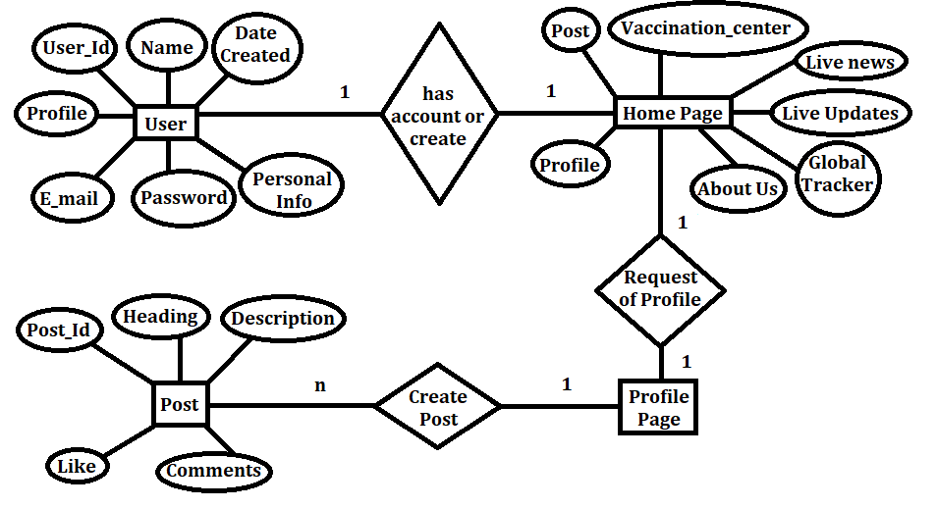
Designs
a) ERD (Entity-Relationship Diagram):

Slide 6
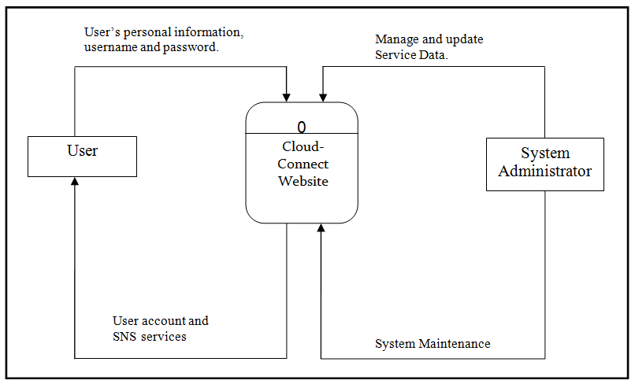
Designs
b) DFD (Data Flow Diagram):
0-Level DFD:

Slide 7
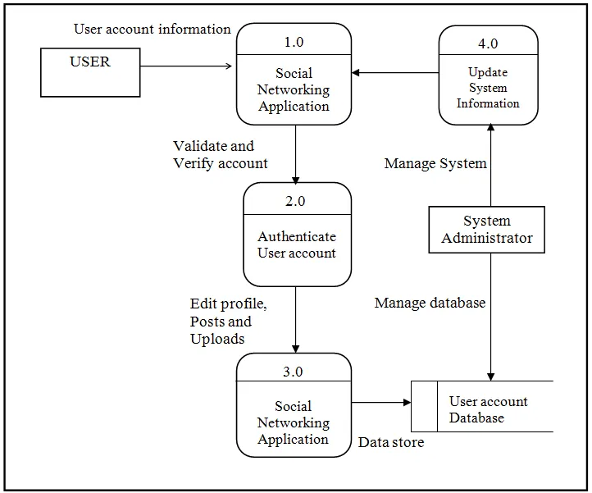
Designs
1-Level DFD:

Slide 8
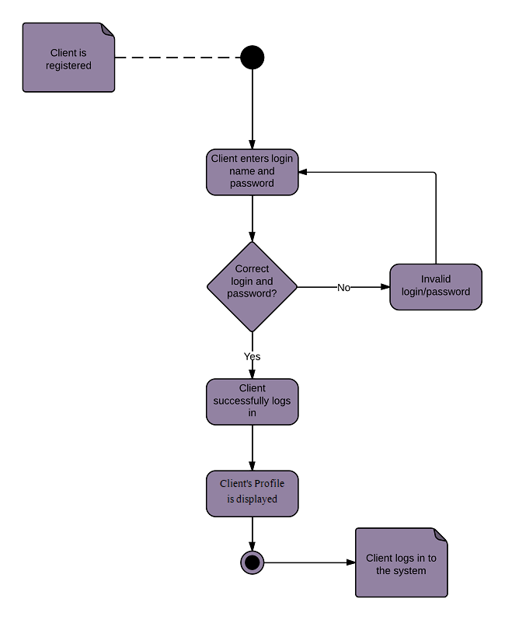
Designs
c) Login Activity Diagram

Slide 9
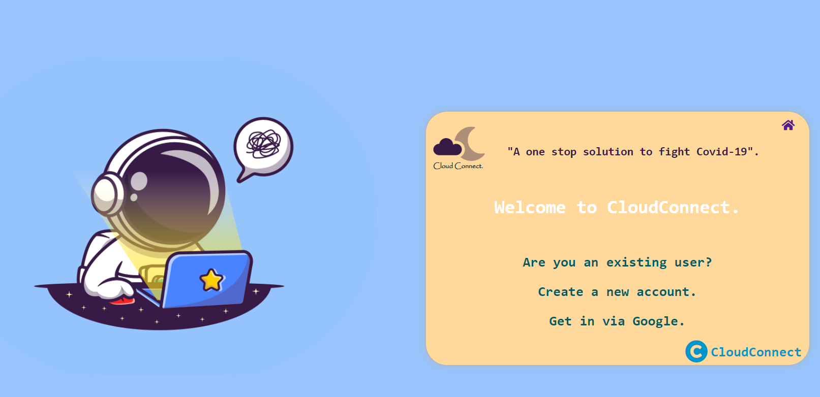
Welcome Page

Slide 10
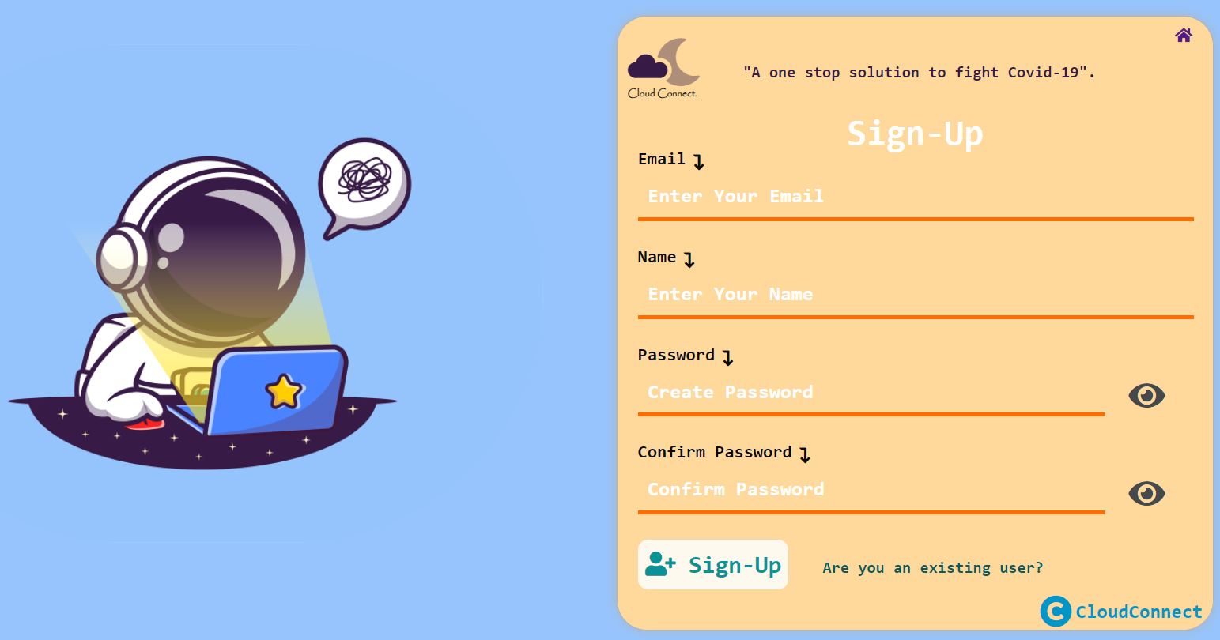
Create a new account

Slide 11
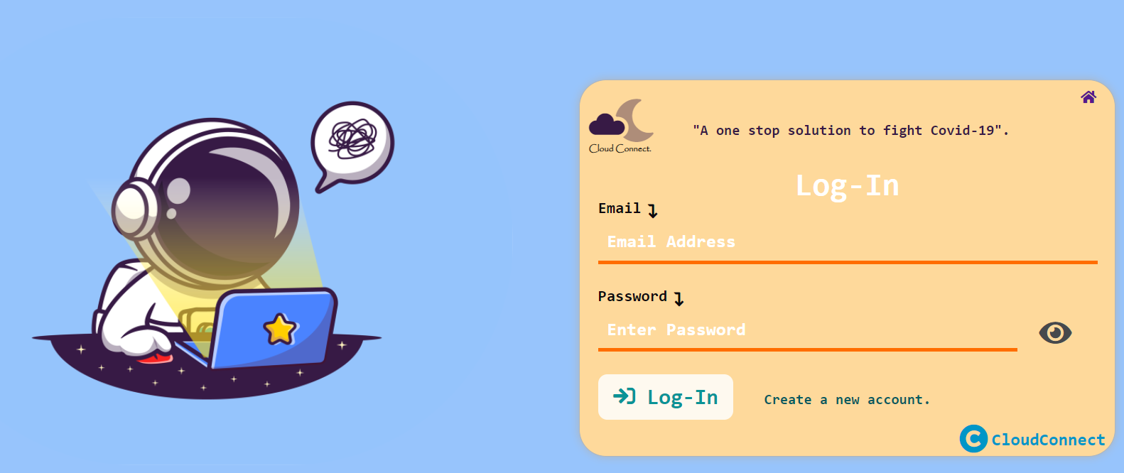
Log-in Page

Slide 12
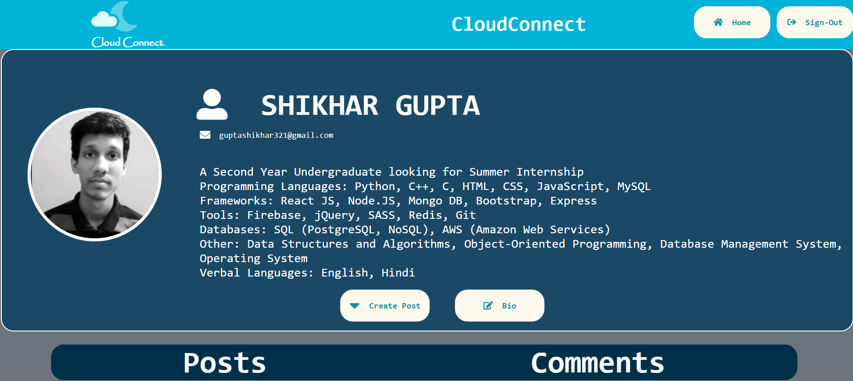
Profile Page

Slide 13
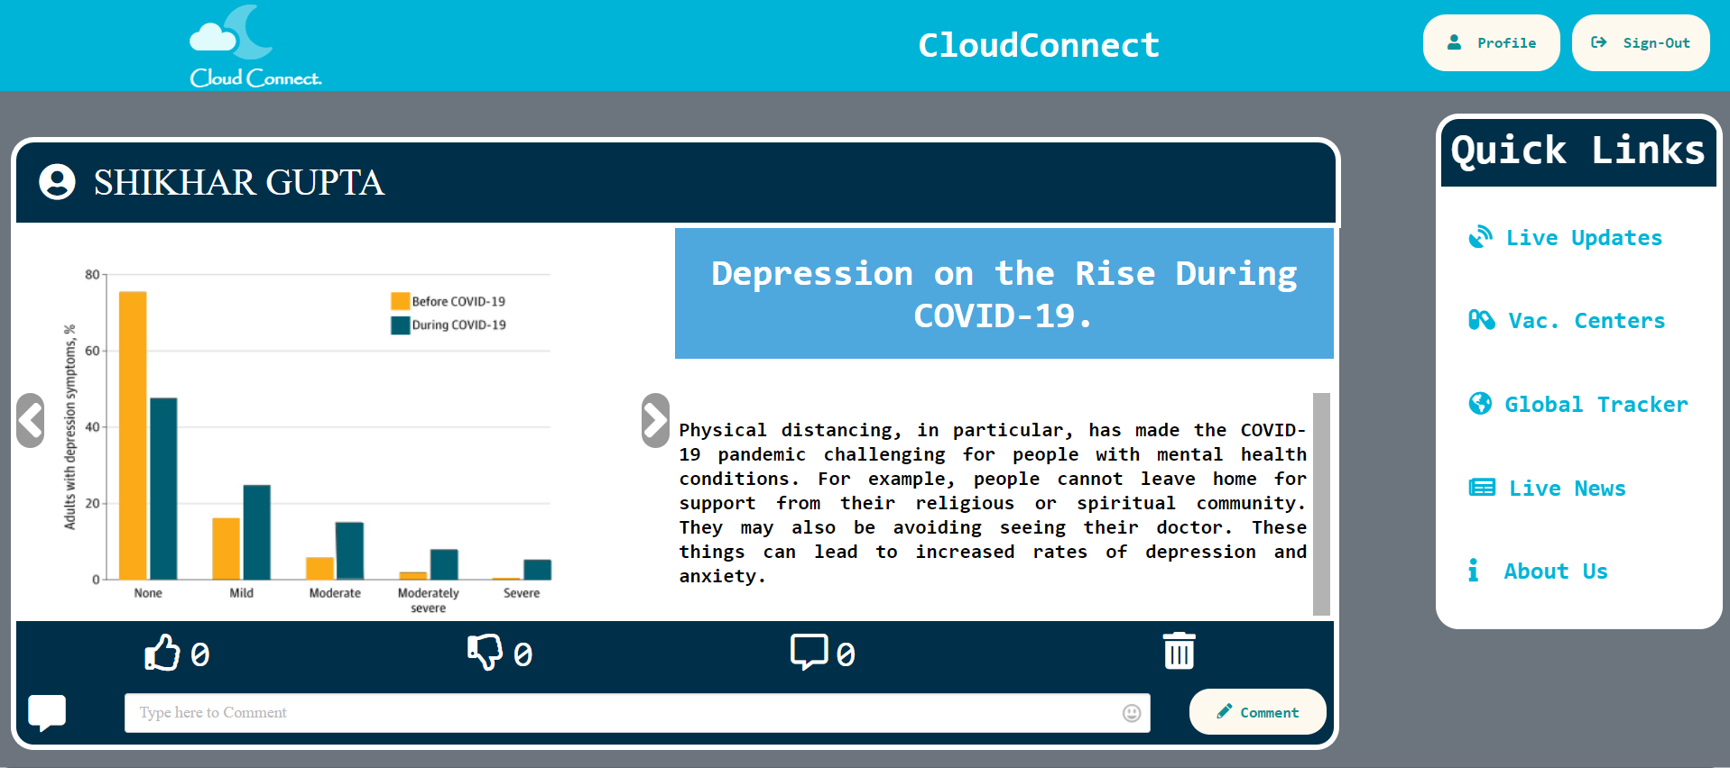
Home Page

Slide 14
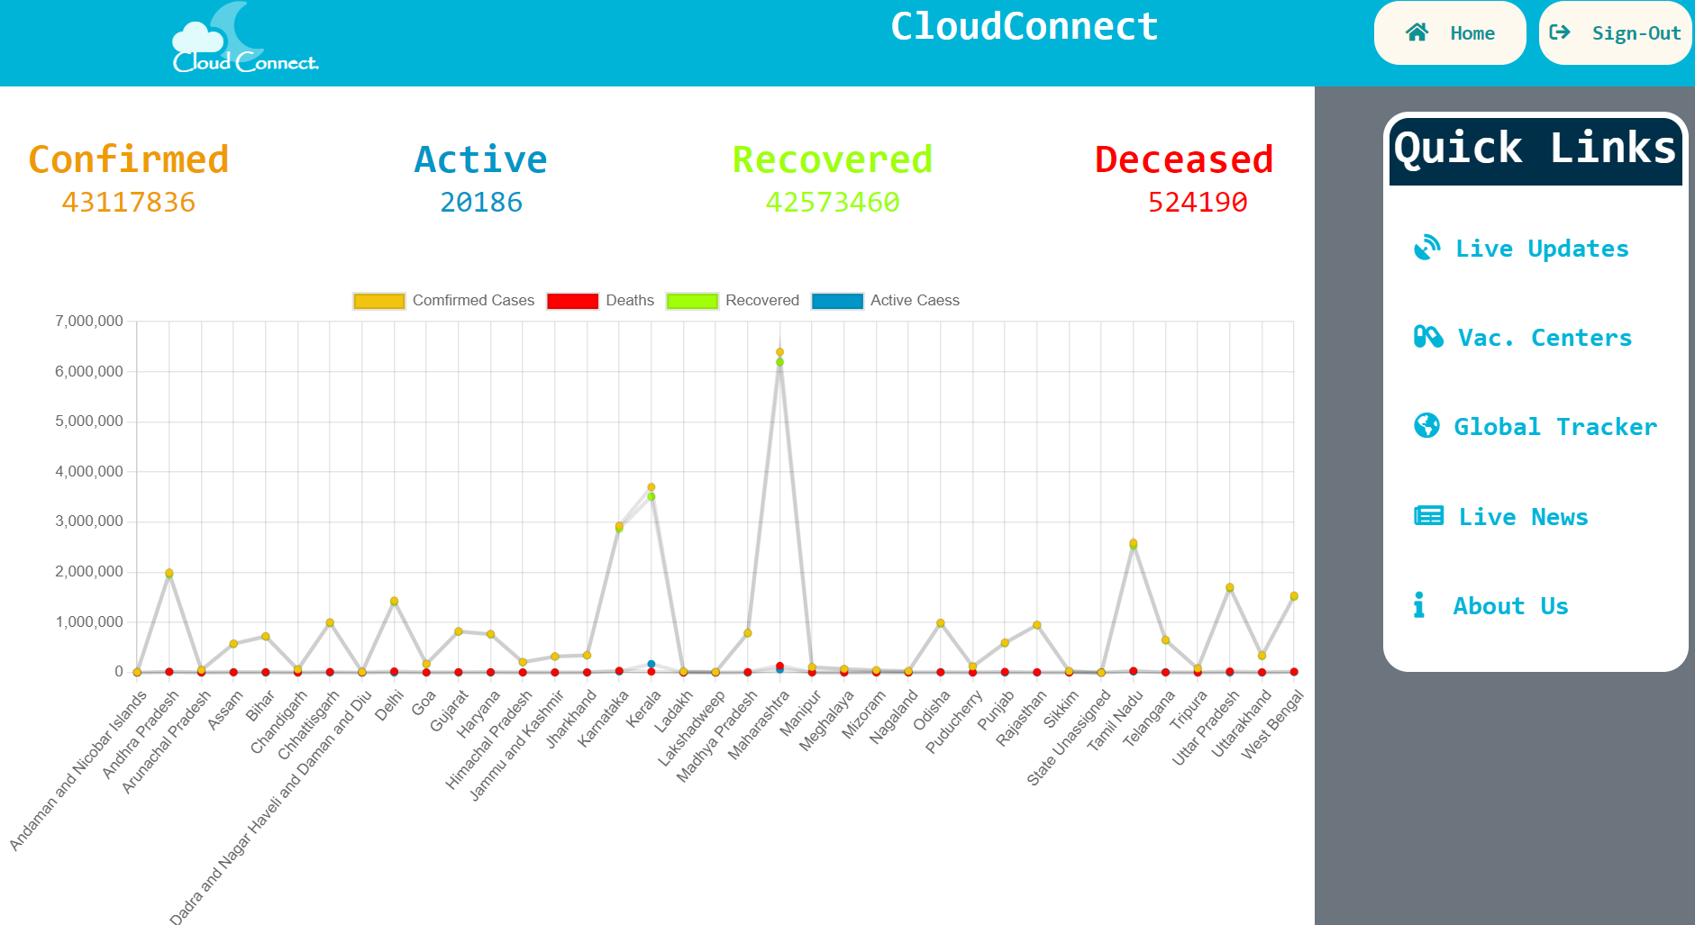
Live Updates

Slide 15
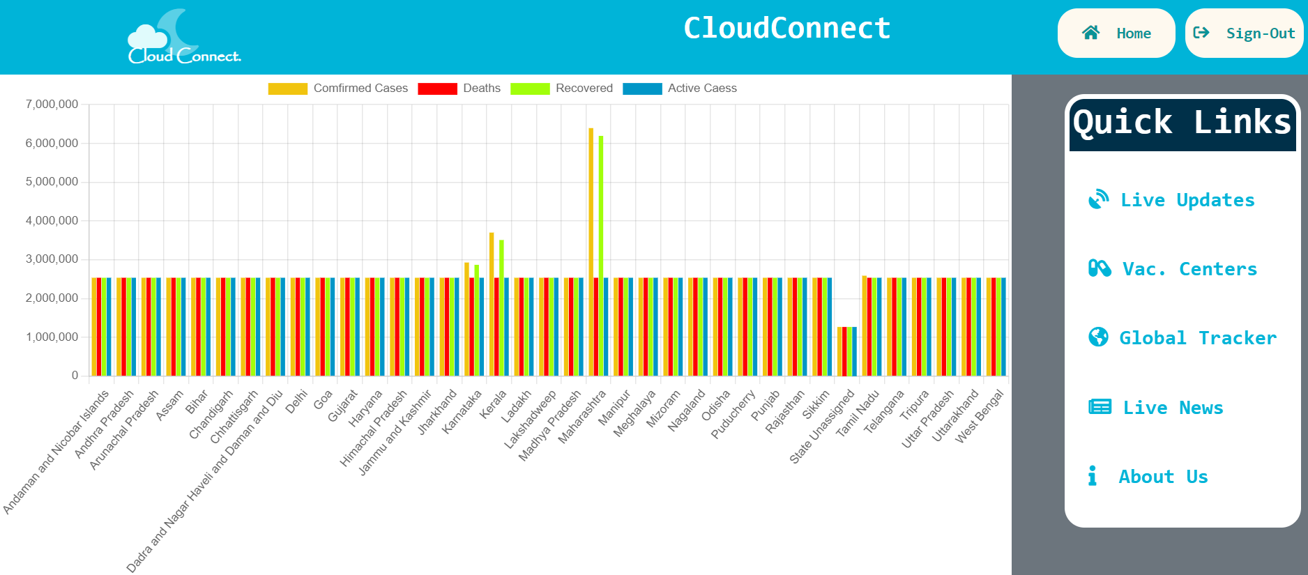
Live Updates

Slide 16
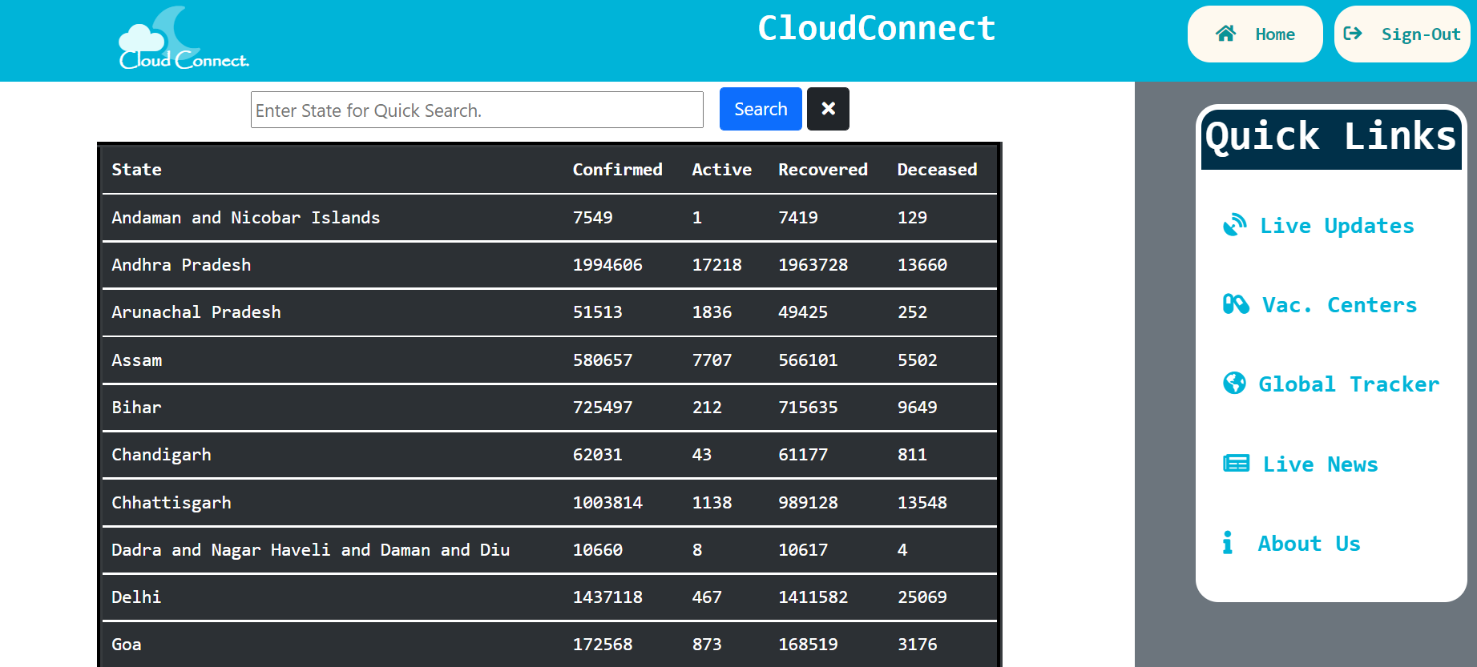
Live Updates

Slide 17
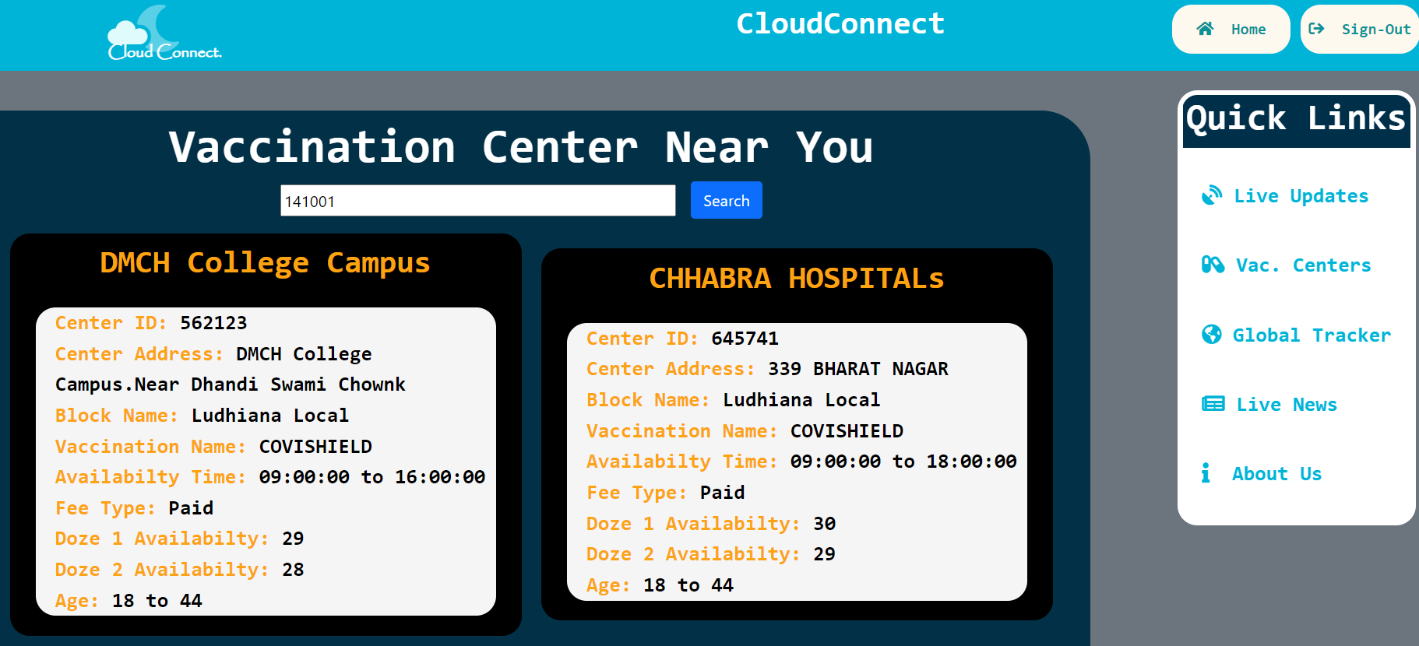
Vaccination Centre

Slide 18
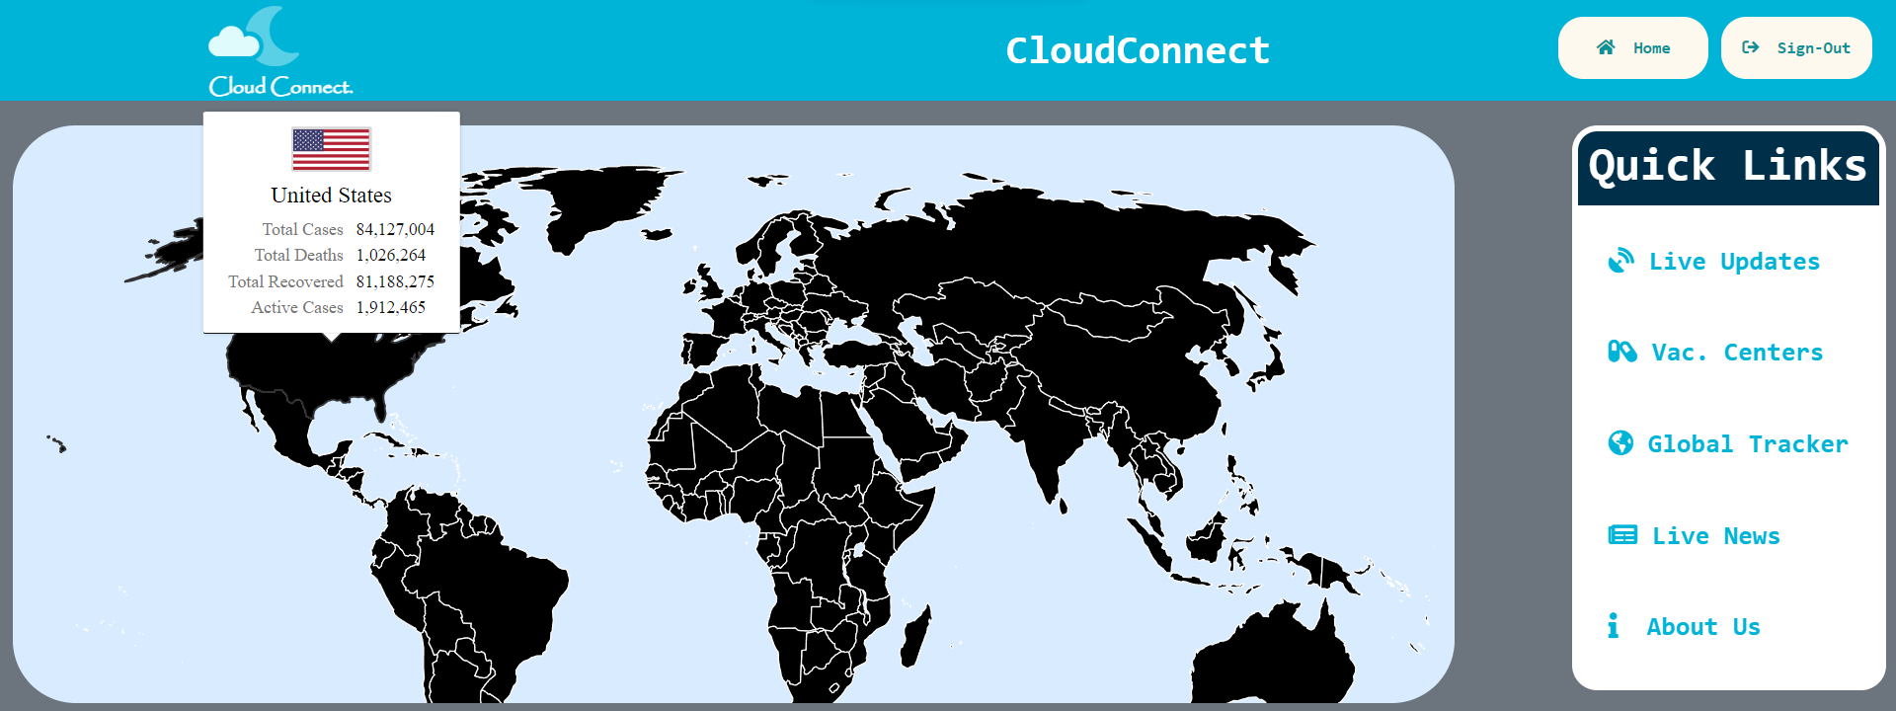
Global Tracker

Slide 19
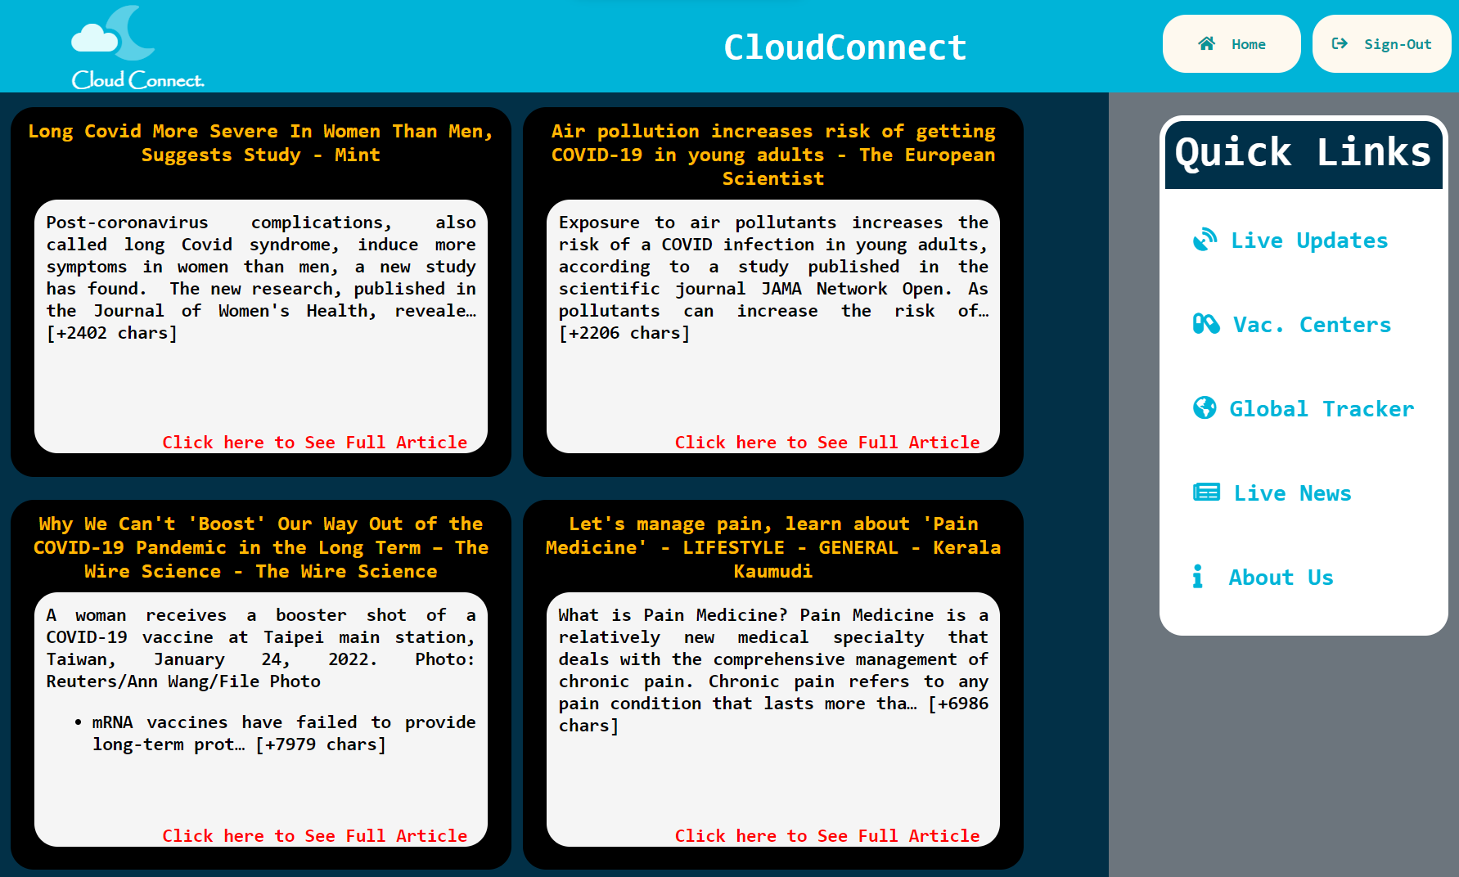
Live News

Slide 20
Future Scope
This website can include the following features in future:
Booking vaccination slots
Downloading of Vaccine certificates.
Verification of Vaccine certificates through QR Code.
These features could have been implemented if time would not limit us. Further, this project can be used to build more complex product which can help larger people.

Slide 21
Thank You

